Slide 1


You see what your tools let you see
Rajarshi Guha | CADD GRC, 2019
©2019 Vertex Pharmaceuticals Incorporated 01/13

Slide 2

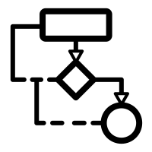

Outline
Q
What is a small molecule doing inside the human body?

Slide 3
Sapir Whorf for data visualization
The structure of a language determines or greatly influences the modes of thought and behavior characteristic of the culture in which it is spoken.
Sapir & Whorf
The limits of the tool shapes my reality
Bridget Cogley
https://www.tableaufit.com/sapir-whorf-data-visualization-tool-shapes-reality/
Notes:
https://www.tableaufit.com/sapir-whorf-data-visualization-tool-shapes-reality/
https://www.ncbi.nlm.nih.gov/pmc/articles/PMC3572715/
Zuni don’t differentiate between orange & yellow and so can’t tell things apart and Russian (light blue/blue) – can differentiate colors

Slide 4

You don’t always have the whole truth

Slide 5
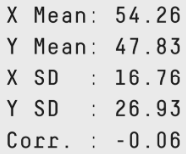
The datasaurus dozen

Slide 6
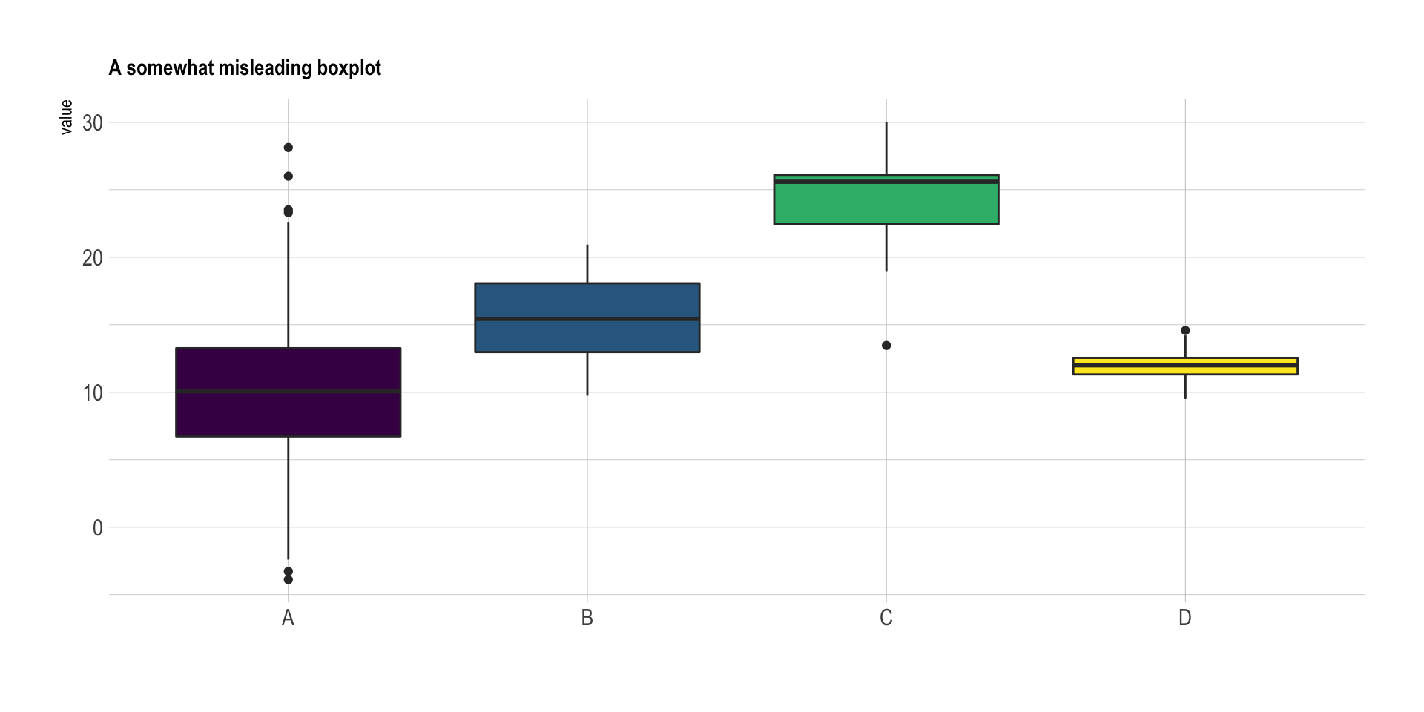
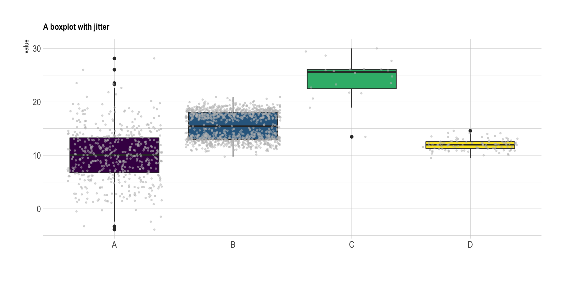
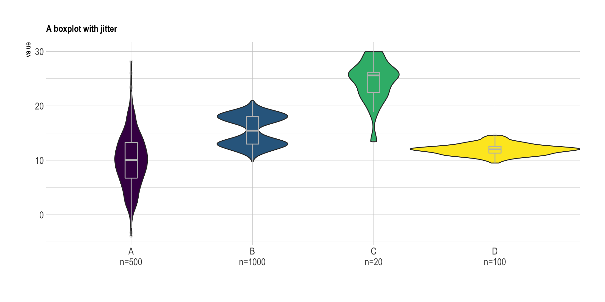
Bins and boxes
https://www.data-to-viz.com/caveat/boxplot.html
Notes:
Suggests group C is higher
But if we jitter the points, C doesn’t have enough data to justify that – goes to statisticay significance vs effect size

Slide 7
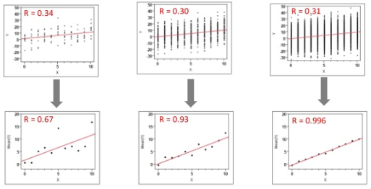
Bins and boxes
Kenny & Montanari, JCAMD, 2013, 27, 1-13

Slide 8
Bins and boxes for predictions
Assay Readout
Notes:
Sumatriptam
Hepatocyte clearance

Slide 9
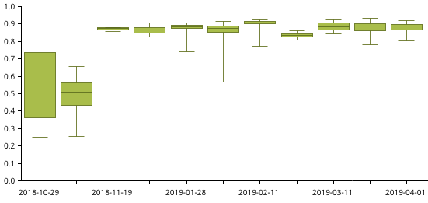
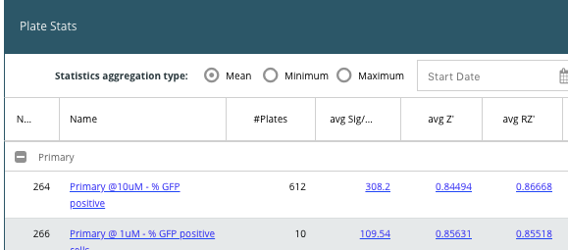
Just show me the data
HTS plate statistics are important to judge performance of an ongoing screen
Does the tool display Z’ for all plates?
Should it? How to toggle between all vs clean?
Notes:
Important to know *what* data is being shown

Slide 10
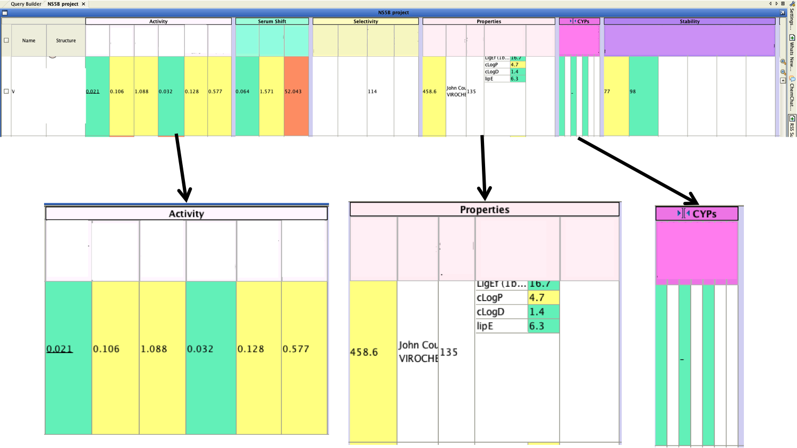
Just show me the data
Notes:
Underlying visualization is the data
Having access to all the relevant data is a key requirement to getting the whole picture
Important that it be organized in a helpful manner

Slide 11
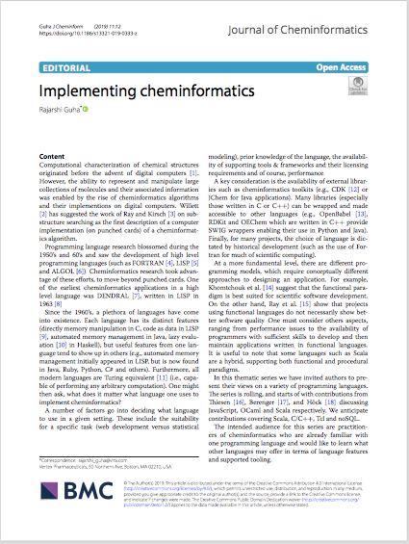
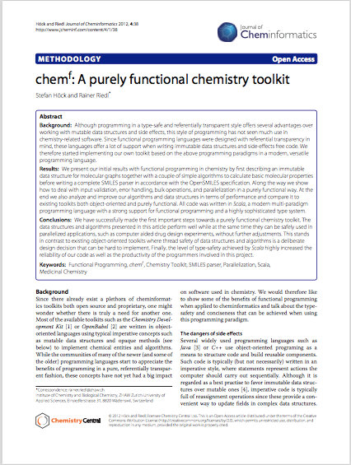

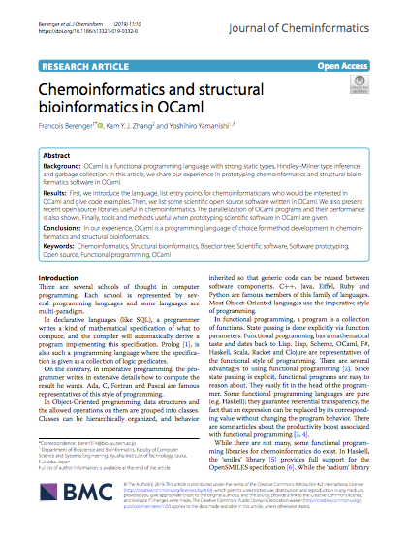
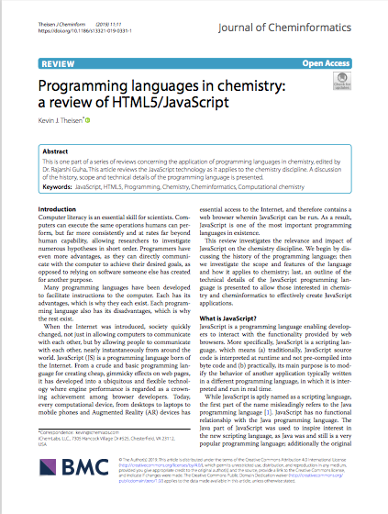
(Programming) language matters
Choice of programming language affects tool development
Imperative
Functional
Constraint
Probabilistic
Language paradigms can make things easier or harder
Expressivity
Interoperabilty
Scalability
Correctness
https://www.biomedcentral.com/collections/programming-languages
Notes:
Iverson, Kenneth. Notation as a Tool of Thought. Communications of the ACM, August 1980, Volume 23 Issue 8, Pages 444–465.

Slide 12
Switching representations
Test N drugs against M drugs, pairwise
Goal is to identify pairs that synergize
Easy to identify most synergistic pair
Non-trivial to find set of compounds whose combinations are the most synergistic
Drug 1 | Drug 2 | Synergy Metric
Methylene blue | Reserpine | -1.73
Artesunate | Reserpine | -1.81
Methylene blue | Miconazole | -1.63
Artesunate | Halofantrine | -0.90
Artesunate | Mefloquine | 0.04
Methylene blue | Sarpogrelate | 0.46
Methylene blue | Lumefantrine | 0.75
Artesunate | Lumefantrine | 1.51
ML238 | Clobetasone butyrate | 1.20
Genz-669178 | Clobetasone butyrate | 1.02
Verapamil | Clobetasone butyrate | -1.38
Mott et al, Sci Rep, 2015, 5, 13891

Slide 13
Switching representations
Synergy metrics used to weight edges
Compute Minimum Spanning Tree
Set of edges connecting all nodes that minimizes sum of edge weights
Most Synergistic Subset (MSS)
Mott et al, Sci Rep, 2015, 5, 13891

Slide 14
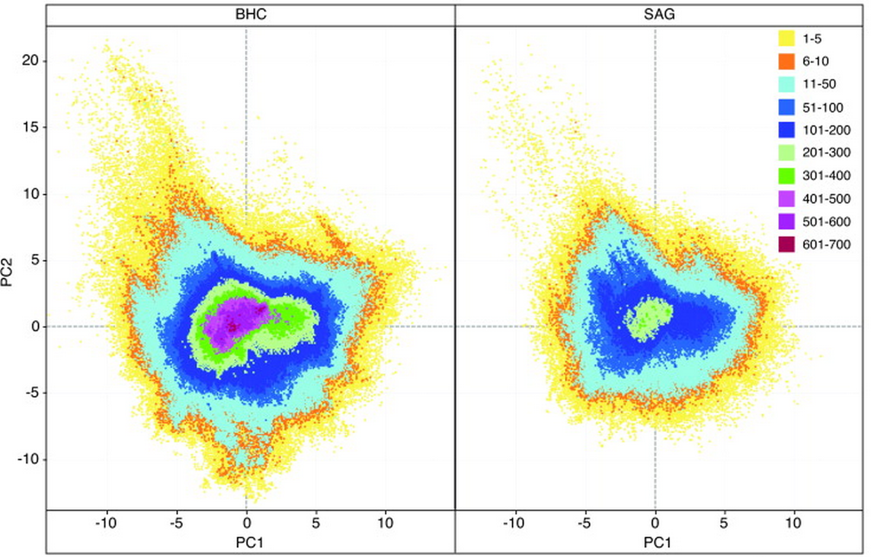
Characterizing chemical libraries
Most comparisons employ a reduced (numerical) representation of the structure
Fingerprints, BCUTs, physicochemical descriptors
Perform comparisons in the new space
PCA, SOM, MDS, GTM, …
Schamberger et al, DDT, 2011, 636-641; Brian McClain, Vertex; Krier et al, JCIM, 2006, 512-514;

Slide 15
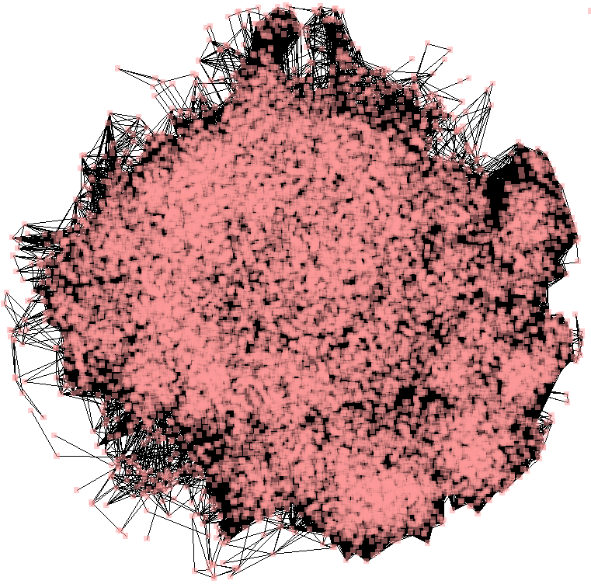
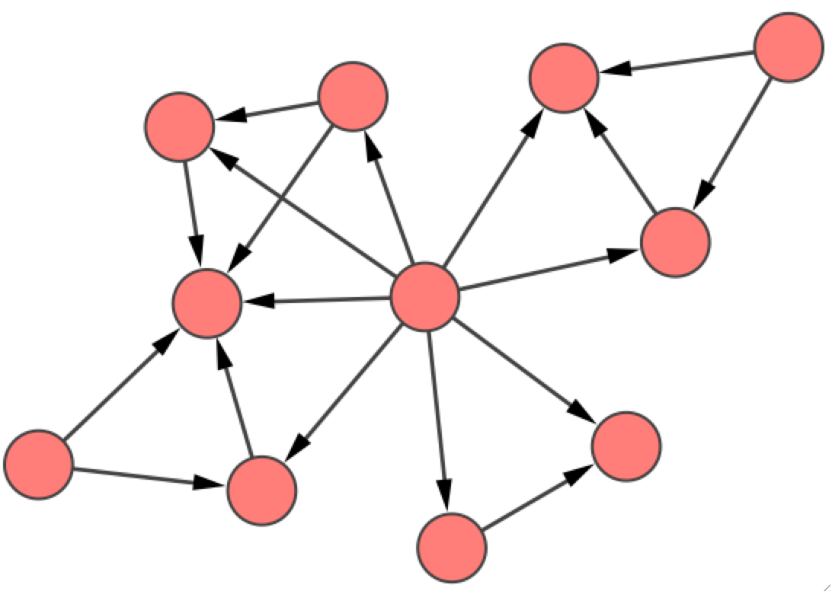
Scaffold network representations
Scaffolds are generated by exhaustive decomposition of frameworks
Scaffolds are nodes, connected by directed edges
4 compounds
1912 compounds
https://spotlite.nih.gov/ncats/scaffoldnetwork
Notes:
A molecule with SSSR of cardinality k can potentially generate 2^{k} unique scaffolds

Slide 16
Metrics for the complete network
Examined vertex-level measures of centrality
Closeness, betweenness, …
Notes:
Resultant distributions can be quantified (say using a KS test)
Betweenness centrality quantifies the number of times a node acts as a bridge along the shortest path between two other nodes.
Comparing these distributions accounts for common scaffolds (overlap) and disjoint scaffolds simultaneously

Slide 17
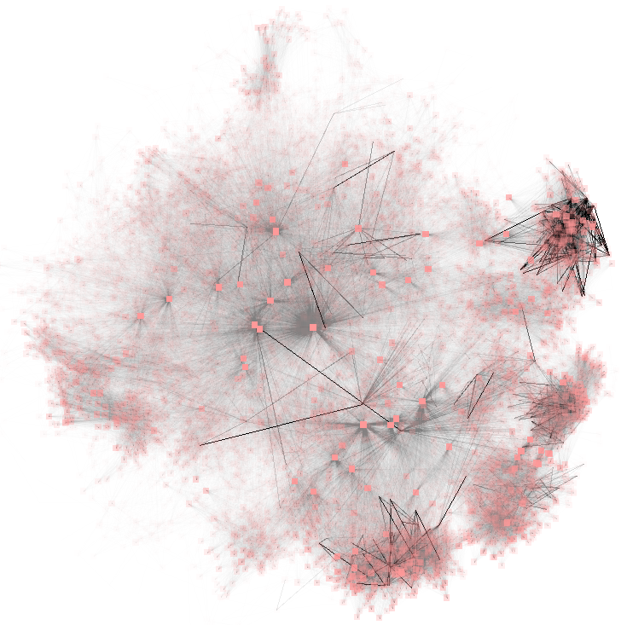
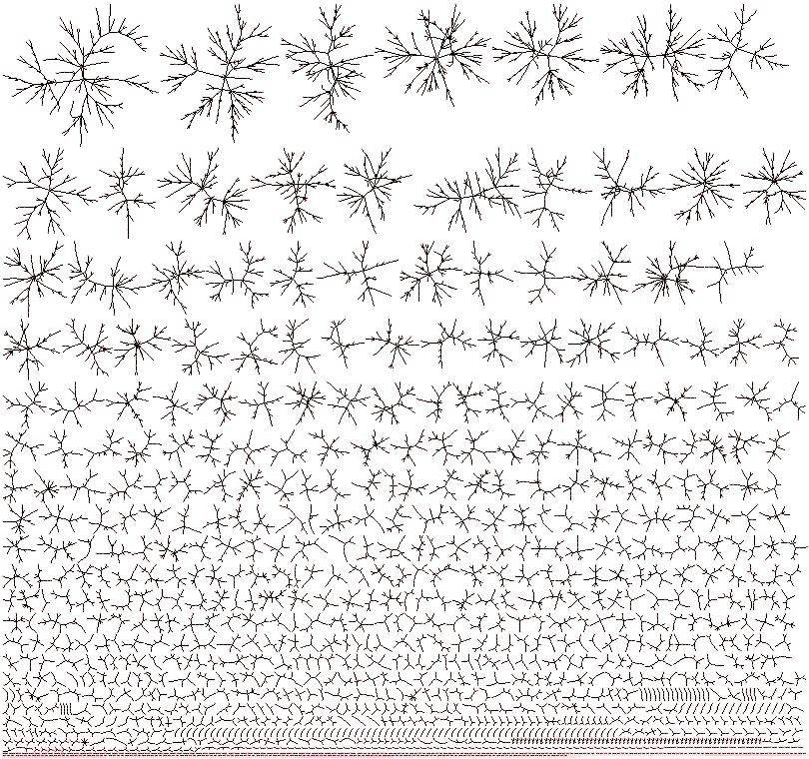
Scaffold network to scaffold forest
Disconnected components
structurally related scaffolds, scaffolds diversity
Singletons
scaffolds with no superstructure
Branching within connected components
scaffold complexity
MIPE, 1912 compounds
Notes:
Edges shaded by edge betweeness – low betweenness low transparency
Nodes transparency is a function of edge count – more edges more transparent

Slide 18
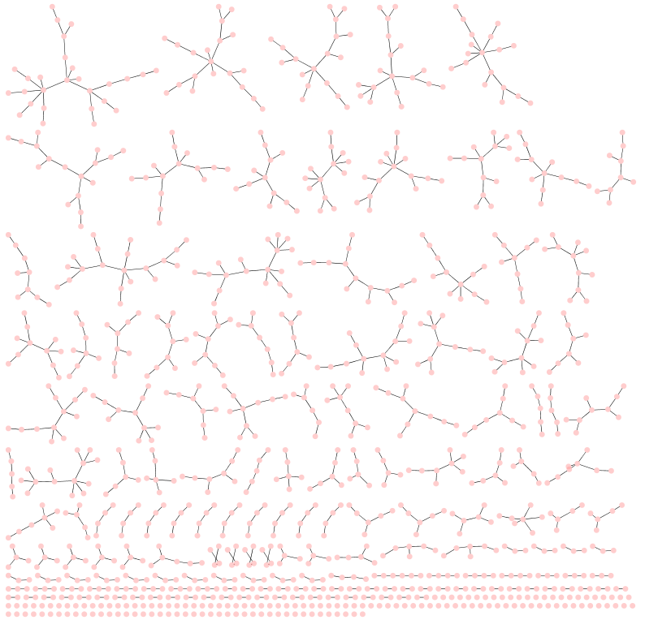
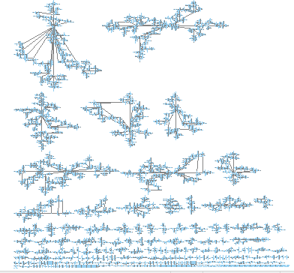
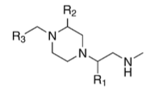
Forest size vs library size
A large library doesn’t imply a large forest
Forest size is a function of scaffold diversity
CL1420, 31K combinatorial library
ChemDiv, 409 Natural Products

Slide 19
Summarizing forests
A key feature is the nature of branching in individual trees
Characterized by I_{D} - information theoretic descriptor of branching derived from the distance matrix
I_{D} = 978
I_{D} = 3456
I_{D} = 90794
I_{D} = 979252
Bonchev & Trinajistic, IJQC, 1978, 14, 293-303

Slide 20
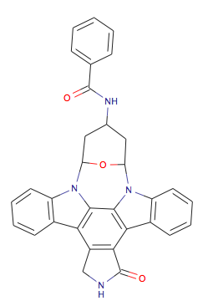
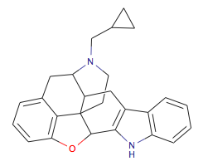
Exploring the forest
The metric also allows us to drill down
Select scaffolds of given branching complexity
Identify scaffolds of given complexity range across different libraries (equivalent to finding holes in scaffold coverage)
LOPAC, I_{D} = 10214
MIPE, I_{D} = 10197

Slide 21






Access to all the data
The ultimate limitation to getting the whole picture is the data you have – internal & external
Integration is boring but worth it
The benefits of integration are
Guidance
Summary
Serendipity

Slide 22
How do we see all there is to see?
Have access to all the data
If you know the different representations, make sure your tools support them
No one tool will let see the whole picture
Make sure you have a toolbox – with tools that work together

Slide 23
Acknowledgements
Vertex
NCATS
Brian McClain
Brian Goldman
Ben Chittick
Daniel McMasters
Dac-Trung Nguyen
Lu Chen
Brian Mott
Craig Thomas
https://spotlite.nih.gov/ncats/scaffoldnetwork

